Slide 1
Claims Life Cycle
Page <number>

Slide 2

Overview
Claims Life Cycle can be defined with the following 4 steps:
  Generating a Claim
  Filing a Claim
  Administrating a Claim
  Reporting a Claim
Claims processing involves 3 major sub-processes as described below:
  Claims Pre-Adjudication
  Claims Adjudication
  Claims Post-Adjudication
Incase Claims undergo the process of Adjustment would repeat the 4 steps again. (If necessary)
Page <number>

Slide 3
Claims Life Cycle Steps
Claims Life Cycle
Generating a Claim
Filing a Claim
Reporting a Claim
Administrating a Claim
Page <number>

Slide 4
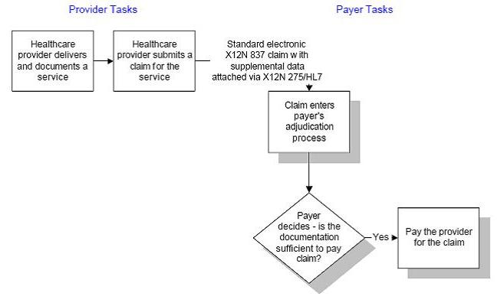
Claims Life Cycle Flow 1
Page <number>

Slide 5
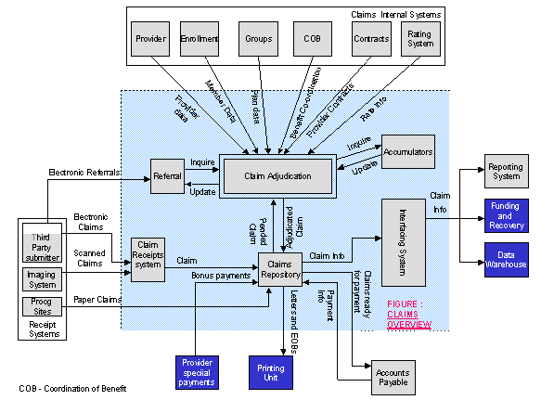
Claims Life Cycle Flow 2
Page <number>

Slide 6
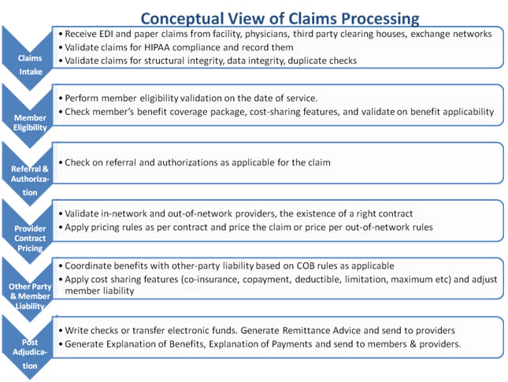
Conceptual View
Page <number>

Slide 7
Claims Pre-Adjudication
Page <number>

Slide 8

Claims Pre-Adjudication
Claims Pre-Adjudication sub process involves the
below steps before the claim gets picked up for
Adjudication:
  Data Validation
  Member Pick
  Provider Pick
  Eligibility Pick
  COB Check
  Pre-Authorization / Referral Check
  Duplicate Claim Check
  Timely Filing Check
  Clinical Edit and Bundling
Page <number>

Slide 9

Data Validation
This process ensures that basic set of information needed to process
the claim is available on the claim and guarantees that every data
value is correct and accurate. Some of the important information that
needs to be on claims areas follows:
Member
    SSN
    Last Name
    First Name
    Date of Birth
    Subscribers Name
    Subscribers SSN
Provider
    NPI no.
    Name
    Taxonomy codes
    Zip code
    Physician Name
    Attending Physician Name in case of UB 92 Claim.
Service Details
    Diagnosis Code
    Procedure Codes
    Submitted Amount
Page <number>

Slide 10

Member Pick
This process ensures that the member information Picked
up from the incoming claim is valid and unique.
Some of the important information that are usually used to
Uniquely identify the member are as follow:
Membership Number
SSN
Member Last Name
There might be scenarios wherein the membership
information being picked might be
Incomplete
Mismatched etc
then the claim could be rejected in future without even being
adjudicated or may need special processing . such cases
can be validated and if necessary tagged in this step.
Page <number>

Slide 11

Provider Pick
Provider pick process identifies providers – Billing and
Rendering that have provided the service as per the claim
and picks up all the information necessary to process the
claim.
Some of the details which are picked and checked as part of
provider pick are as below:
Billing provider’s NPI,
Billing provider’s name,
Attending physician’s name,
Providers TIN no.,
Rendering providers NPI,
Rendering providers TIN no.,
Rendering providers name
Type of contract with the billing provider,
Services for which provider is contracted,
Provider’s contract on DOS
Page <number>

Slide 12

Eligibility Pick
Eligibility pick process ensures that the member eligibility
Information are as per the membership and are valid
according to the plan.
Eligibility pick process can have below picks and checks for
the membership.
  Policy Plan Validation
  Determination of Eligibility Start and End Date
  Employee/Retiree/COBRA Determination
  Type of Plan – Services and Allowable Amount
  Dependant Covered Determination
Page <number>

Slide 13

Covered and Non-Covered Services
Covered Services : is a Medically Necessary service or supply (specified in the plan) for which benefits may be available.
Example: Covered Services includes doctor visits, hospital stays, rehabilitation and therapeutic services, and behavioral health and substance abuse services.
Non-Covered Services: might be a Medically Necessary Service or supply but then it is not specified in the plan for which benefits may not be available.
Example: Cosmetic Surgery is not included in any of the health plan as a covered service until and unless it is investigated and proved as a requirement due to an accidental need .
Page <number>

Slide 14

Coordination of Benefits (COB) Check
To determine the obligations of payers when a member is covered under two or more separate insurance plans ,the National Association of Insurance Commissioners (NAIS) has come up with standards called as COB (Coordination of Benefits)
COB ensures that insurance claims are not paid multiple times when a member is insured under multiple insurance plans
Coordination of Benefits (COB) applies when:
  Both spouses cover their family through their employers
  Both spouses are covered by the same insurance carrier but work for different employers
  Member is federal Medicare eligible
  Member is retired from one job and actively employed elsewhere
  Member is injured in an automobile accident
  Member is injured on the job
  The primary subscriber has more than one employer
Page <number>

Slide 15

Pre-Authorization / Referral Check
This process ensures that incase the plan of the member
requires a pre-authorization/referral is obtained or not before
the services were taken.
Pre-Authorization :
when a member requires a service that costs him/her a high $ amount value for the insurer to evaluate the claim genuinely and smoothly.
Some of the plans enlists the services that will require Pre-Authorization from the insurer to perform the service.
An Authorization number would be provided by the insurer and the member/provider would give the unique number in the claim if it the service required it prior to perform.
Referral :
Some of the plans would require a referral before they see a physician/specialist. Mostly relevant in Managed care plans. In HMO it is a mandate.
For such plans referrals are known as PCP (Primary Care Physician).
Member/provider is given a referral ID to be used in the claim by the referred physician.
Pre-Authorization/Referral can be generated in two ways:
Call up Customer services
Using online system of the carrier
Page <number>

Slide 16

Duplicate Claim Check
A claim received by the Insurer that matches another claim for the same Injured Party, which already appears in the Insurer’s claims database is known as a Duplicate Claim.
Duplicate claims are identified by checking the claim details with the claims in the history systems which has stored all the claims submitted to it for reimbursements and identify if This service has been provided for this member earlier by the same provider on the same DOS.
If it is found to be true then the claim is tagged as duplicate claim and is denied by the carrier.
During the duplicate check process, the claim may be evaluated to check the degree of duplication of a claim and thus be categorized as a :
  Soft duplicate
  Hard duplicate
Page <number>

Slide 17

Timely Filing Check
The number of days allowed to submit a claim from provider is known as “Timely Filing”.
In Provider contracts, there are often clauses wherein the provider is given a stipulated time period from the DOS or DOJ to file his/her claim.
This is done to encourage providers to submit the claims on time and not to wait for the claims to get collated.
Timely filing of claims helps carriers in many ways including
  Meet any reporting requirements to the government
  To ensure their solvency ratio is maintained
  To maintain money in different account pools and avoid any kind of denial of payments.
  Ensure better services to providers, coz late filling may lead to missing/incorrect information being submitted to the carrier.
Providers are incentivized for timely filing and penalized for not filling the claims on time
Page <number>

Slide 18

Clinical Edit and Bundling
Clinical edits refers to a process that evaluates billed
codes in relationship to each other for the purpose of
identifying :
Unbundled procedures
Surgical coding errors
Invalid data relationships
Patterns of utilization deviating from practice standards
Diagnoses or procedures that may be invalid for the age and/or gender of the patient.
Bundling refers to a edit process that identifies a single
comprehensive code to describe services performed when
two or more codes have been billed. (*Rebundling)
Unbundling refers to a edit process that describes two or
more codes for a single comprehensive code that describes
the entire procedure code.
Page <number>

Slide 19
Claims Adjudication
Page <number>

Slide 20
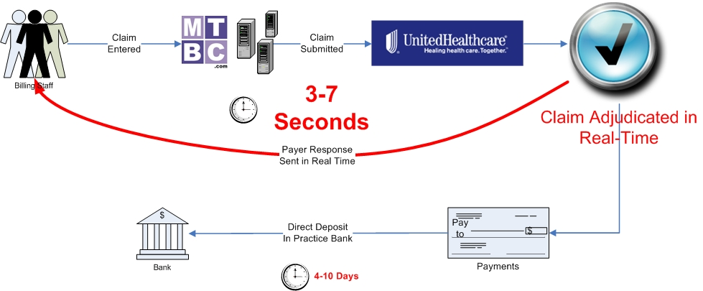
Claims Adjudication
Claims Adjudication process involves the following sub-processes :
  Determining Eligibility
  Applying Benefits
  Identifying Payment Terms
The final outcome of the Claims Adjudication process is :
  Pay/Pend/Deny a Claim
  Claim Payments
  Claim Update
The results obtained from the Claims Adjudication sub-processes and the final outcomes are the input to the next process in claims life cycle.
Page <number>

Slide 21
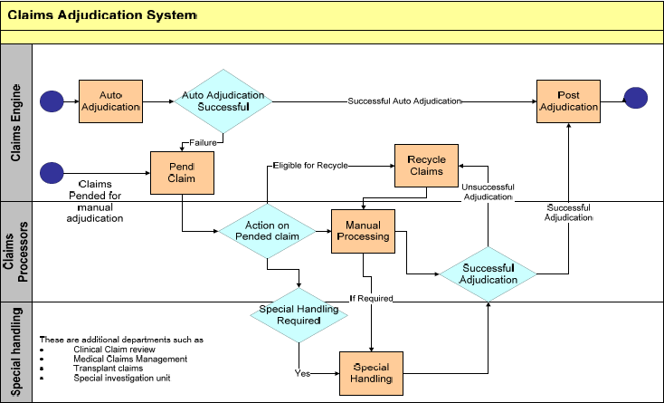
High Level Claim Adjudication Flow
Page <number>

Slide 22


Benefits Calculations
These are few more member expanses which a member need to pay apart from the premium he paid in the beginning of the year.
  Co-Pay
  Co-Insurance
  Deductible
  OOP (Out-of-Pocket) Limit
These are also called as cost-sharing factors of Health Insurance to control the miss utilization of the services.
Page <number>

Slide 23
Co-Pay
Co-Pay is also referred as Co-Payment is a fixed $ amount that a member need to pay each time he/she visits the doctor’s place.
Copay is paid when the service is availed
Co-Pay amount value depends on the Network (IN), Visits and services.
Copay varies for different services. Copay charged for a service is directly proportional to the cost of the service
Co-Pay is paid once for same service on the same day to the same provider. If any of these things change copay is to be paid again.
For example:
Charges incurred = $ 50
Co-Pay = $ 10
How much will the member pay and how much will the Insurer pay, in the above scenario?
Page <number>

Slide 24
Co-Insurance
Co-Insurance is a fixed % of the medical expenses incurred. Usually 4 provisions are followed: 60/40, 70/30, 80/20 and 90/10.
Insurer always pays the larger share.
Co-Insurance is calculated during the claims adjudication phase.
Co-Insurance depends on the Network (IN and OON) and services.
For a service, either copay or coinsurance is applicable. Usually, both are not applicable at the same time.
For example:
Charges incurred = $ 900
Co-Insurance = 80/20
How much will the member pay and how much will the Insurer pay, in the above scenario?
Page <number>

Slide 25
Deductible
Deductible is the annual fixed amount that a member must pay before the Insurer or plan or benefits pay.
The amount depends on the plan type and deductible can be of a high- or low- deductible plan.
Deductible can be of two types from members perspective,
    Family Deductible
    Individual Deductible
If a plan has both deductible and co-insurance then deductible will be paid first then the co-insurance.
For example:
Charges incurred = $ 2000
Co-Insurance = 80/20
Deductible = $ 500
How much will the member pay and how much will the Insurer pay, in the above scenario?
Page <number>

Slide 26
OOP
OOP (Out-of-Pocket) is a combination of deductible, co-pay and co-insurance.
OOP defines the upper limit of a members expenses in a plan year.
After the OOP limit for a plan year is met, the member has to pay only co-pay and rest will be paid by the insurer.
For example:
Charges incurred = $ 2000
Co-Insurance = 80/20
Deductible = $ 500
OOP limit = $ 700
How much will the member pay and how much will the Insurer pay, in the above scenario?
Page <number>

Slide 27
Order of Benefit Calculations
If a plan has all the components then the during the claims adjudication process the order to be followed for benefits calculation is :
    Deductible
    Co-Pay
    Co-Insurance
For Example:
Charges incurred = $ 2000
Co-Pay = $ 10
Co-Insurance = 80/20
Deductible = $ 500
OOP limit = $ 1000
How much will the member pay and how much will the Insurer pay, in the above scenario?
Page <number>

Slide 28
Illustration 1
Steve Scanlon is covered by a traditional indemnity health insurance plan that specifies a yearly $500 deductible and includes a 25% coinsurance provision. The overall coverage for the year for Steve is $15,000.00. The out of pocket maximum for Steve is $3,000. Steve became ill, was hospitalized, and incurred $2,000 in medical expenses that are covered by his health plan. Assume that these expenses were the first that Steve incurred during the calendar year. What amount of these medical expenses will Steve pay? What will his health insurance plan pay?
Answers:
After paying $500 to meet his policy’s deductible, Steve must pay 25% of the remaining balance of $1,500. Steve’s coinsurance payment equals $375. After paying both the deductible and coinsurance, Steve’s out-of-pocket expenses total $875. The insurer will pay the remaining $1125.
Total covered expenses $2,000
Less deductible –500 (Steve pays)
TOTAL $1,500
Less coinsurance (0.25 x $1,500) –375 (Steve pays)
Insurer will pay $1125
Page <number>

Slide 29
Illustration 2
Continuing from the Illustration 1, Steve is hospitalized again, and
incurred $3,000 in medical expenses that are covered by his health plan.
What amount of these medical expenses will Steve pay? What will his
health insurance plan pay?
Answers:
Total covered expenses: $3,000
Deductible: ($0) (Steve has paid)
TOTAL: $3,000
Coinsurance (0.25 x $3,000) :( $750) (Steve pays)
Insurer will pay: $2,250
Page <number>

Slide 30

Claim Repricing
Third Party contracts are sometimes used for repricing the claim. These Contracts are normally between Empolyer and TPA.
Under the contract, TPA will renegotiate the provider payment directly with provider.
In case of out of network claim, system routes that claim to TPA.
TPA reprice the claim and send back to insurance
New Repriced amount is used for claim payment
On EOB and ERA, the details about repriced is mentioned.
Page <number>

Slide 31
Claim Payment Process
Submitted amount
Submitted amount on each service
Priced amount
Priced amount gives Allowed amount.
This is Normally payment to provider
Out of Pocket computation
Out of Pocket based on
Plan decides patient responsibility.
COB Computation
If COB is applicable,
COB calculations are applied .
Accumulators
Based on Accumulators
Patient responsibility may change .
Page <number>

Slide 32
Claim Updates
These are some of the updates that are performed after every claim is successfully
Adjudicated.
Accumulator updates
  This involves updating of Various accumulators depending upon the processing of the claim.
  Co-pay
  Deductible
  Co-insurance
  OOP Limit
  Office Visits etc.
Referral updates
  Referrals are updated for no of visits after the claim has been processed properly.
Claims database updates
  Processed Claims stored for maintaining History.
Page <number>

Slide 33
Illustration 4
From the last 3 discussed illustrations, please list the values for below accumulators :
  Deductible?
  Out of pocket Limit?
  Yearly Max?
Answers:
  Deductible - $500
  Out of pocket Limit $2875
  Yearly Max $1125+$2250+$3750
Page <number>

Slide 34
Claims Post Adjudication
Page <number>

Slide 35

Claims Post-Adjudication
Also can be called as “Claim Payment & Distribution” is
the process where the following post adjudication
actions takes place :
  Check Payment
  Explanation of Payments (EOPs)
  Explanation of Benefits (EOBs)
  Electronic Remittance Advise (ERAs) / 835
Page <number>

Slide 36

Check Payment
The first step in the post-adjudication process is to advise the “Check Payment” to the identified payee in the claims adjudication process.
Check payment is a different process under the “Payment System” where they perform the below steps:
  Generate a Check
  Validate a Check
  Post a check
The banks are also involved in the check payment process based on the plan and account types.
Page <number>

Slide 37

EOPs and EOBs
After one or more Claims are submitted to a payer, the payer will determine how much the provider will be compensated for the procedures performed.
When this payment is made to the provider, the patient is usually informed that the payer is making the payment by receiving a statement, called an "Explanation of Benefits“ or “EOB”, from the payer.
The provider is paid and is informed as to which procedures are being paid via a statement called an "Explanation of Payments" or "EOP".
Page <number>

Slide 38
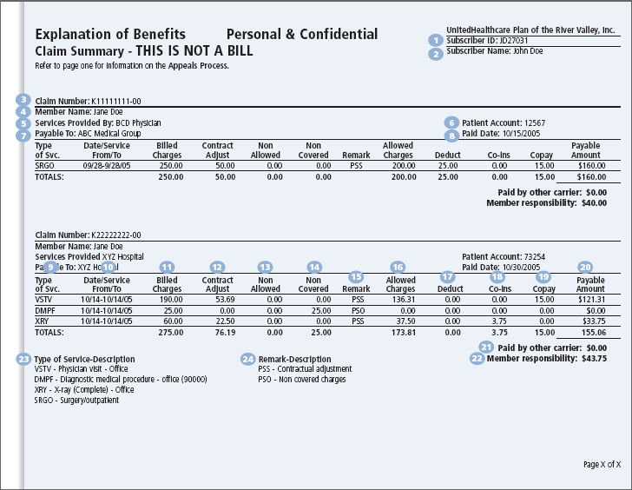
Snap Shot: Member EOBs
Page <number>

Slide 39

Electronic Remittance Advise (ERAs)/835
The Electronic Remittance Advice, or 835, is the electronic transaction which provides claim payment information in the HIPAA mandated ACS X12 835 4010 A1 format.
ERAs provide all necessary explanation about providers’ claim payment and if the claims are denied, it would then contain the required explanations for the denial reason.
ERA is sent by payers to providers only.
The only difference between ERA and EOP are that EOPs are paper forms and ERAs are the electronic transactions.
Page <number>

Slide 40
Claims Adjustment
Page <number>

Slide 41

Claims Adjustment Concept
This process of handling and settling claims or the amount
requested by a policyholder or claimant because of a loss or
damages suffered and need some modifications to the
submitted claims.
Types of Adjustment:
Check-related adjustments
Non-check-related adjustments
Retroactive rate adjustments
Mass adjustments
1. Check-Related Adjustments A provider can initiate a
check-related adjustment when an excess payment has
been made. The provider sends a check in the amount of
the excess payment with the adjustment form and
appropriate attachments.
Claims Adjuster
Page <number>

Slide 42

Claims Adjustment Concept
2. Noncheck-Related Adjustments is an adjustment
initiated by a provider due to an underpayment or excess
payment. It does not include a refund check from the
provider. The following are the types of non-check related
adjustments:
Underpayment adjustment – If the adjustment was
requested because the provider was underpaid, the
adjustment is processed based on the adjustment request
form and appropriate documentation.
Overpayment adjustment – If the request is to adjust an
overpayment, the overpaid amount is deducted from future
claim payments through an account receivable
adjustment.
Full overpayment adjustment – For overpayment
adjustments, the accounts receivable can be set up to
recoup the entire amount of the claim.
Page <number>

Slide 43
Claims Adjustment Concept
3. Retroactive Rate Adjustments : for Long-Term Care Facilities The rate-setting contractor for LTC
facilities, Myers and Stauffer, LC, initiates retroactive rate adjustments. When Myers and Stauffer update
a per diem rate for a specific time frame, the new rates are forwarded to the provider.
Retroactive rate adjustments can result in an increase or decrease in payment, depending on whether
the new rate is higher or lower.
4. Mass Adjustments :A provider can initiate a mass adjustment. Mass adjustment requests
are applied to change a large number of paid claims at one time. This can apply to many providers or
one provider: Positive adjustments, or additional money to the provider, are corrected by additional
payment through the regular claim payment process.
Negative adjustments, are recouped through the accounts receivable function and are usually collected
through the offset of future claims payment.
Mass adjustments can be used when a system problem caused claims to be paid incorrectly, or when a
rate for a procedure code changed retroactively.
Page <number>

Slide 44
Illustrations
Any use, copying or distribution without written permission from UnitedHealth Group is prohibited.
Page <number>

Slide 45
Illustration 5
Tom Tsai is insured by both a traditional indemnity health insurance
plan, which is his primary plan, and a health plan, which is his secondary
plan. Both plans have typical coordination of benefits (COB) provisions,
but neither has a nonduplication of benefits provision. Mr. Tsai incurred
$1,000 of medical expenses from a specialist and assigned benefits to
the specialist, who filed claims with both plans. The traditional plan paid
a total benefit amount of $600 and notified the health plan of this payment.
The health plan determined that, if it had been Mr. Tsai's primary plan, it
would have paid a benefit amount of $900.
According to the COB provision, the total amount that the health plan
owed on these medical expenses was?
Page <number>

Slide 46
Illustration 6
David Martin is covered by a managed healthcare plan that specifies a $300
deductible and includes a 30% coinsurance provision for all healthcare
obtained outside the plan’s network of providers. In 1998, Ms. Martin became
ill while she was on vacation, was hospitalized, and incurred $2,000 for
healthcare that she obtained outside her plan’s network, but that is covered
by the plan. Ms. Martin incurred no other out-of-network expenses during
1998. Of the $2,000 in covered out-of-network expenses that Ms. Martin
incurred, she is responsible for paying a total of???
Page <number>

Slide 47
Illustration 6
Claim Number | K11111111-00 | Claim Example 1
Member Name | Mark Paul
Service Provided | XXX Hospital
Paid To | XXX Hospital
Type Of Serv | Date/Service From/To | Billed Charges | Contract Adjust | Non- Allowed | Non- Covered | Remark | Allowed Charges | Deductible | Co-Ins | Co-Pay | Payable Amount
VSTV | 06/14-06/14/10 | 190 | 53.69 | 0 | 0 | PSS | 136.31 | 0 | 0 | 15
DMPF | 06/14-06/14/10 | 25 | 0 | 0 | 25 | PSO | 0 | 0 | 0 | 0
XRY | 06/14-06/14/10 | 60 | 22.5 | 0 | 0 | PSS | 37.5 | 0 | 3.75 | 0
TOTALS:
Page <number>

Slide 48
Illustration 6
A member is enrolled in a PPO plan that pays 90% in network and70% out of
network (assume no deductibles apply). The member is injured and needs
surgery out of network and the hospital and surgeon charges are $4,000. The
carrier determines that the maximum allowable UCR charge for the surgery is
$3,000 (90% of providers in the members geographical area charge $3,000 or
less for this type of surgery). How much will the Member end up paying out of
his/her own pocket?
Page <number>

Slide 49

Questions???
Page <number>

Slide 50
Thanks !!!
Page <number>

